Slide 1
Deep Neural Networks
(AIML ZG511)

Slide 2
Transformer(with examples)
Session 13
(02nd August 2026)

Slide 3
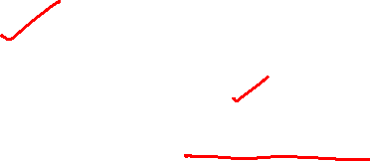

Slide 5


Slide 6


Slide 7


Slide 8


Slide 9
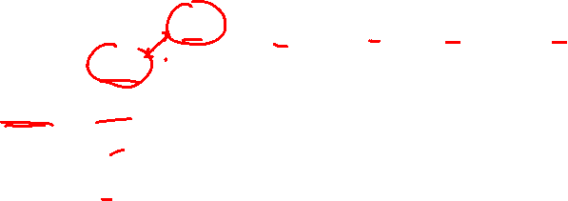

Slide 10


Slide 15


Slide 16
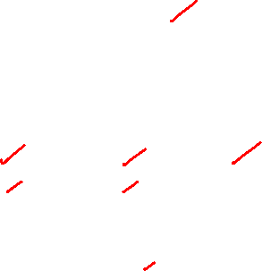

Slide 18
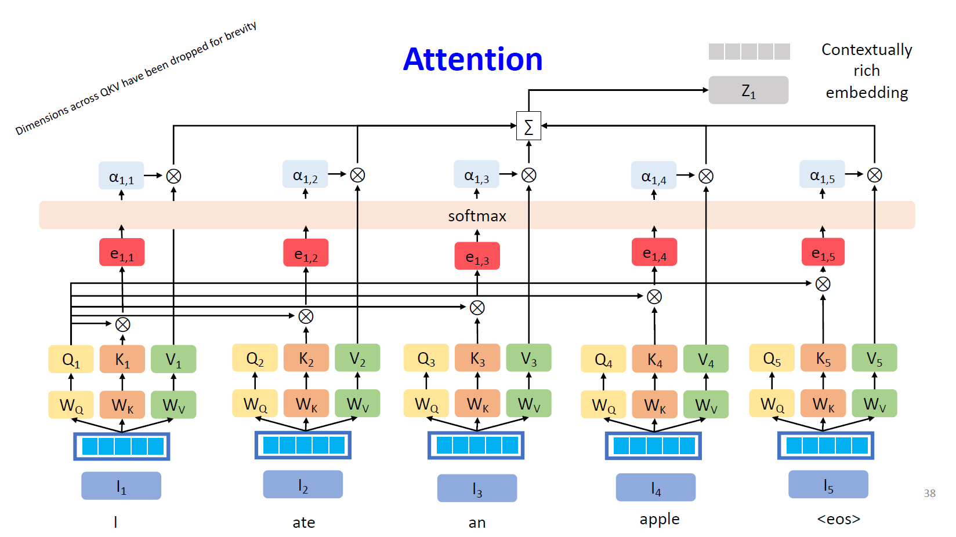
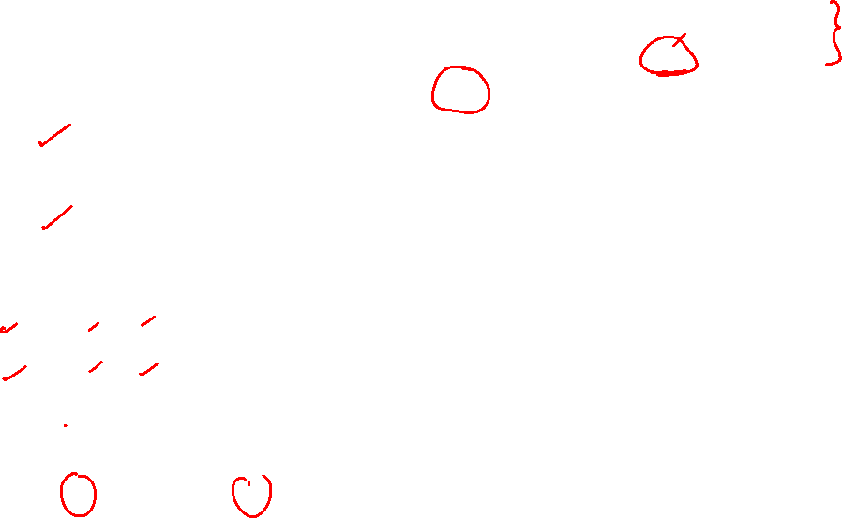

Slide 20
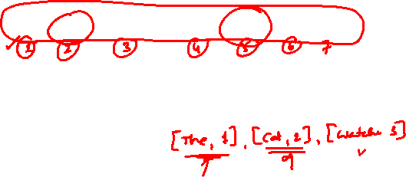
Positional Embeddings
positional encoding indicates the absolute and relative position of the tokens in the sequence.
For example, in “The cat watches the dog run fast.”, if the position of “cat” and “dog” were interchanged, it would alter subject and object and thus the meaning of the sentence.

Slide 22


Slide 23
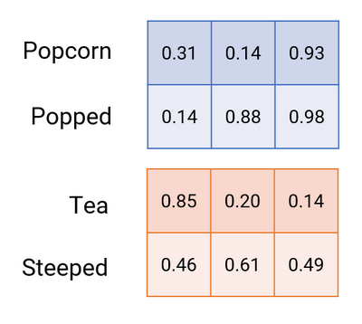
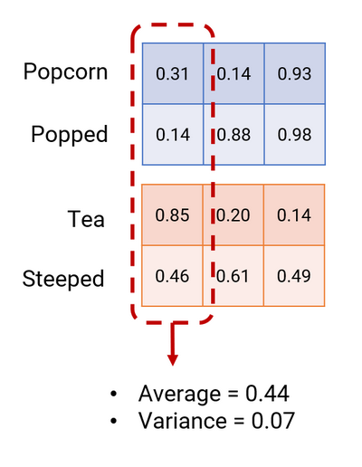
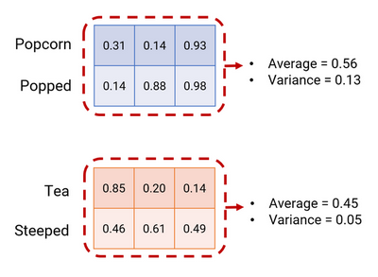
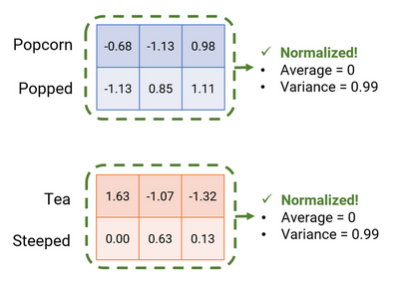
Normalization(Batch and Layer)

Slide 24
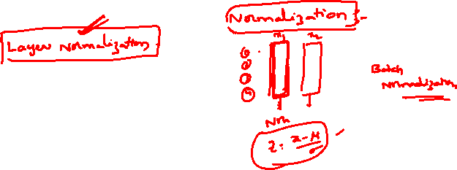
Normalization(Batch and Layer)
Transformers use Layer Normalization (LayerNorm) — not Batch Normalization like CNNs typically do. Let's go through why, how it works, and a worked example.
Why LayerNorm and not BatchNorm?
BatchNorm normalizes across the batch dimension (i.e., across different examples, for a fixed feature). This works well for images but is problematic for sequences: sentences have variable length, batch statistics get noisy with small batches, and it creates a dependency between different sequences in a batch — undesirable at inference time.
LayerNorm instead normalizes across the feature dimension, independently for each token, in each example. This makes it stable regardless of batch size or sequence length, and each token's normalization is self-contained.

Slide 25
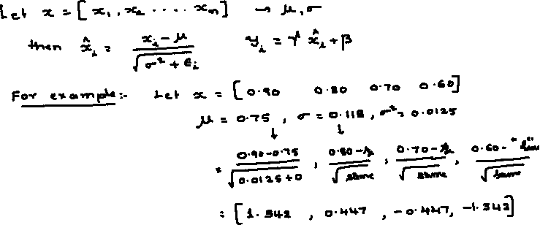

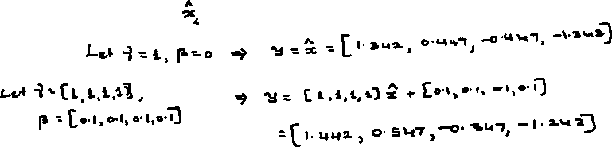
Layer Normalization

Slide 27
TRANSFORMER

Slide 28


Slide 29


Slide 30
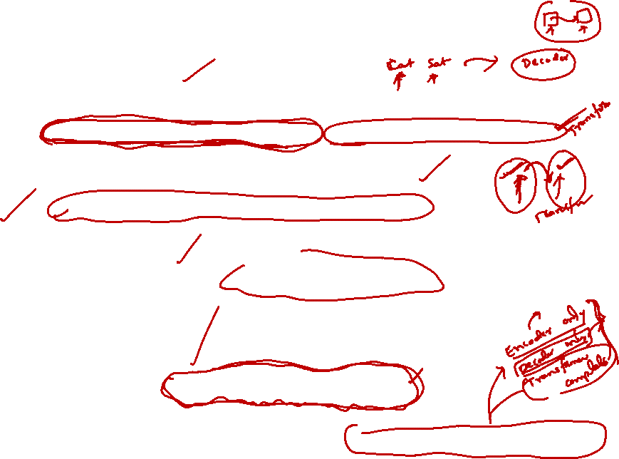

Slide 32
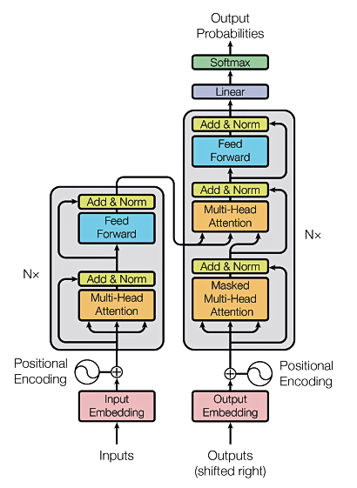
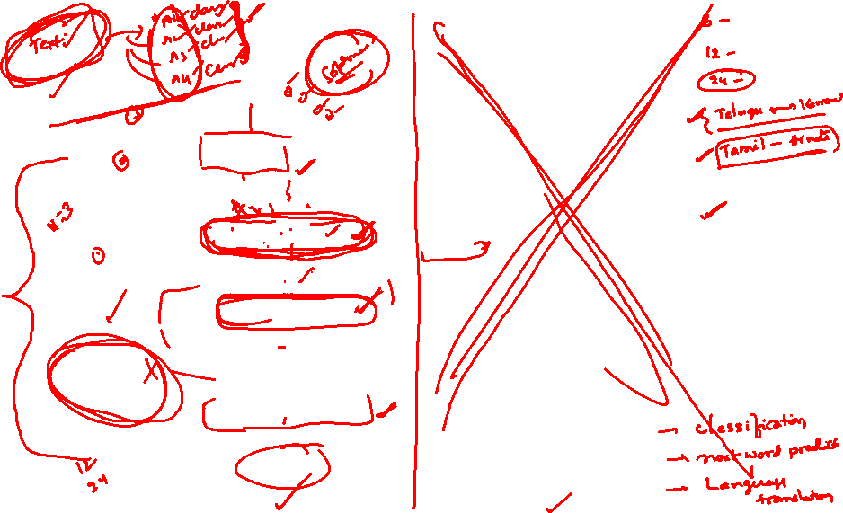
TRANSFORMERS

Slide 33
Transformer _ Encoder Only
(Numerical)
Thanks to LLMs for providing the relevant content

Slide 34
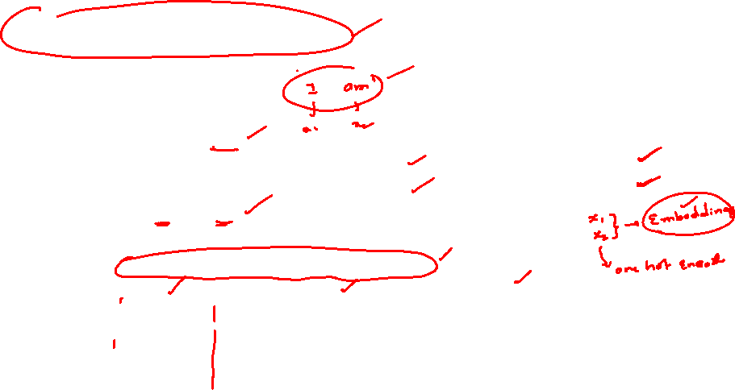
ENCODER-ONLY TRANSFORMER
Setup
Input embeddings (X)
Dimension of the model = 4
Dimension of K = Dimension of V = 3
single attention head,
Input: I am
2 tokens: x1 = "I", x2 = "am"
 | d1 | d2 | d3 | d4
x1 | 1 | 0 | 1 | 0
x2 | 0 | 1 | 0 | 1
Weight matrices (learned parameters, 4×3 each)
Wq
Wk
Wv
1 | 0 | 1
1 | 0 | 0
0 | 0 | 1
0 | 1 | 1
0 | 0 | 1
1 | 1 | 0
0 | 1 | 0
1 | 1 | 0
0 | 2 | 0
0 | 3 | 0
1 | 0 | 3
1 | 1 | 0
Encoder-only means:
No masking — every token sees every other token
No decoder , no cross-attention
Used for understanding tasks (BERT, RoBERTa): classification, NER, embeddings

Slide 35
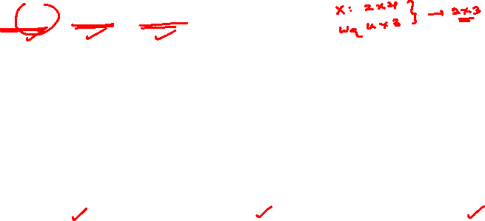
Step 1 — Project into Q, K, V
1
Q = X·Wq K = X·Wk V = X·Wv
Worked example — Q1:
x1·Wq = [1·1+0·1+1·0+0·0, 1·0+0·0+1·0+0·1, 1·1+0·0+1·1+0·1] = [1, 0, 2]
Q
K
V
 | q1 | q2 | q3
x1 | 1 | 0 | 2
x2 | 1 | 1 | 1
 | k1 | k2 | k3
x1 | 0 | 1 | 1
x2 | 2 | 2 | 0
 | v1 | v2 | v3
x1 | 1 | 2 | 3
x2 | 1 | 4 | 0
Each token now has its own Query, Key, and Value vector — three different views of the same embedding, each shaped by a separate learned projection.

Slide 36
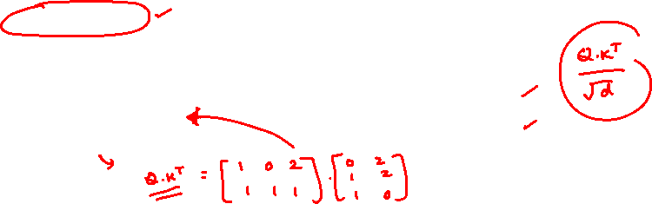
Steps 2–3 — Score & Scale
scores = Q·Kᵀ scaled = scores / √d (d = 3, √3 ≈ 1.732)
Raw scores (Q·Kᵀ)
Scaled scores (÷ 1.732)
 | K1 | K2
Q1 | 2 | 2
Q2 | 2 | 4
 | K1 | K2
Q1 | 1.155 | 1.155
Q2 | 1.155 | 2.309
Why scale by √d?
As d grows, dot products grow in magnitude, pushing softmax into regions with extremely small gradients.
Dividing by √d keeps the scores — and the softmax — well-behaved regardless of dimension.
Token 1 ("I") scores 1.155 against both tokens — a tie.
Token 2 ("am") scores higher against itself (2.309) than against "I" (1.155) — already leaning toward self-focus before softmax even runs.

Slide 37
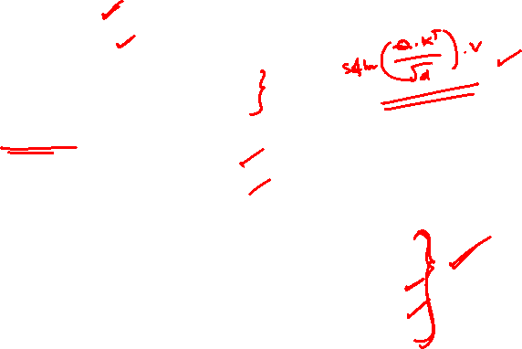
Steps 4–5 — Softmax & Weighted Output
Softmax (row-wise)
Row 1 (token "I"): [0.500, 0.500]
Row 2 (token "am"): [0.240, 0.760]
e^1.155 = 3.17, e^2.309 = 10.07, sum = 13.24
0.240 = 3.17/13.24 , 0.760 = 10.07/13.24
Attention output Z = softmax · V
Z1 = 0.5·[1,2,3] + 0.5·[1,4,0] = [1.000, 3.000, 1.500]
Z2 = 0.24·[1,2,3] + 0.76·[1,4,0] = [1.000, 3.521, 0.719]
Final self-attention output (Z)
 | z1 | z2 | z3
x1 | 1.000 | 3.000 | 1.500
x2 | 1.000 | 3.521 | 0.719
Reading the result
"am" (x2) ends up attending mostly to itself (76%) — its output Z2 is pulled close to V2.
"I" (x1) split evenly (50/50), so Z1 blends V1 and V2.
Attention weights are learned and data-dependent, not fixed.

Slide 38

Completing the Encoder Block
What happens after attention, on the way to the next layer
1
Add & Norm
Residual connection adds the block's input back to Z, then LayerNorm stabilizes the distribution: LayerNorm(X + Z).
2
Feed-Forward
A position-wise network applied identically to every token: FFN(x) = ReLU(x·W1 + b1)·W2 + b2.
3
Add & Norm (again)
A second residual + LayerNorm wraps the feed-forward sublayer before passing output to the next stacked block.
This entire block stacks N times
(N = 12 in BERT-base). Because it is encoder-only, every token attends bidirectionally to every other token — no masking, no decoder, no cross-attention — which is why encoder-only models excel at understanding tasks rather than text generation.

Slide 39
Key Takeaway
Self-attention is a learned, data-dependent weighting scheme.
Key Takeaway
The same architecture, given different Wq/Wk/Wv weights, produces entirely different attention patterns. Here, "I" split its attention evenly across both tokens, while "am" attended mostly to itself (76%) — an asymmetry that falls directly out of training, not out of any hand-coded rule.
Bi directional: Every token attends to every other token in both directions — no causal mask.
Stacked N times: One block repeats (e.g. N=12 in BERT-base) to build deep contextual representations.
Used for understanding : Classification, NER, embeddings — not autoregressive generation.

Slide 40
Transformer _ Encoder Only
(Numerical 2)
Thanks to LLMs for providing the relevant content

Slide 41

Example
Sequence of 3 tokens: "I" "love" "NLP"
Embedding dimension: d(model) = 4 (and here, dₖ = dᵥ = 4 for simplicity)
INPUT EMBEDDING MATRIX X (3 × 4)
I
1
0
1
0
EACH ROW = ONE TOKEN'S EMBEDDING
love
0
2
0
2
Row 1 → "I" = [1, 0, 1, 0]
Row 2 → "love" = [0, 2, 0, 2]
Row 3 → "NLP" = [1, 1, 1, 1]
NLP
1
1
1
1
Goal: turn each row into a new vector that also reflects the other tokens it should “attend to.”

Slide 42
Query, Key & Value Weight Matrices
LEARNED PARAMETERS
Three learned 4×4 projection matrices turn each token embedding into a Query, a Key, and a Value vector. (Simplified integer values here, purely for illustration.)
Q
W^Q
K
W^K
V
W^V
1
0
0
0
0
1
0
0
1
0
1
0
0
1
0
0
1
0
0
0
0
1
0
1
0
0
1
0
0
0
0
1
1
0
0
1
0
0
0
1
0
0
1
0
0
1
1
0
Q = X·W^{Q} K = X·W^{K} V = X·W^{V}

Slide 43
Project Embeddings into Q, K, V
Q = X W^Q
K = X W^K
V = X W^V
I
1
0
1
0
I
0
1
0
1
I
2
0
1
0
love
0
2
0
2
love
2
0
2
0
love
2
2
2
2
NLP
1
1
1
1
NLP
1
1
1
1
NLP
2
2
2
1
Each row of Q, K, and V still corresponds to one token — but now in three different learned “roles”: what it's looking for (Q), what it offers (K), and what it carries (V).

Slide 44
Raw Attention Scores — Q Kᵀ for "I"
Take the query vector for "I" and dot it against every key vector to see how strongly "I" relates to each token (including itself).
Q ("Ia") = [1, 0, 1, 0]
K₁ (I)
[0, 1, 0, 1]
1(0)+0(1)+1(0)+0(1)
=
0
K₂ (love)
[2, 0, 2, 0]
1(2)+0(0)+1(2)+0(0)
=
4
K₃ (NLP)
[1, 1, 1, 1]
1(1)+0(1)+1(1)+0(1)
=
2
Row 1 of QKᵀ = [ 0, 4, 2 ]

Slide 45
Scale, then Softmax
Scaling prevents large dot products from pushing softmax into tiny gradients as dₖ grows.
[0, 4, 2] / 2 = [0, 2, 1]
softmax([0, 2, 1]) = [e⁰, e², e¹] / (e⁰ + e² + e¹) = [1, 7.39, 2.72] / 11.11
ATTENTION WEIGHTS FOR “I”
I
9.0%
love
66.5%
NLP
24.5%

Slide 46

Weighted Sum of V — Output for "I"
Multiply each value vector by its attention weight and sum them — producing a new, contextualized representation of “I.”
0.09
×
[2, 0, 1, 0]
0.665
×
[2, 2, 2, 2]
0.245
×
[2, 2, 2, 1]
Output₁ ≈ [2.00, 1.82, 1.91, 1.575]
This 4-dim vector replaces the original embedding of "I" — now blended mostly with "love" (66.5%) and "NLP" (24.5%), the tokens most relevant to it.
Repeating Steps for rows 2 and 3 of Q yields contextualized vectors for “love” and “NLP,” completing the 3×4 output matrix.

Slide 47
Transformer _ Encoder Only(with multi head attention)
(Numerical 3)
Thanks to LLMs for providing the relevant content

Slide 48
Setup
Two tokens, projected through the encoder's first attention block
The example
INPUT EMBEDDINGS
DIMENSIONS
x₁
[ 1, 0, 1 ]
3
model
size of each token embedding
x₂
[ 0, 1, 1 ]
2
k and v
size of Q/K/V after projection
2
heads (h)
parallel attention computations
2
seq length
tokens in this example
Think of x₁ and x₂ as two words' embeddings sitting side by side in a sequence of length 2.

Slide 49

Head 1 — Self-Attention
Project to Q, K, V → score → scale → softmax → weighted sum
Query / Key / Value projections
Token | Q | K | V
x₁ | [2, 1] | [1, 2] | [2, 1]
x₂ | [1, 2] | [2, 1] | [1, 1]
WORKED EXAMPLE — TOKEN x₁
Q·K scores: Q₁·K₁ = 4 Q₁·K₂ = 5
Scaled: 4/1.414 = 2.828
5/1.414 = 3.536
Softmax: e^2.828 = 16.92
e^3.536 = 34.34
weights = [0.330, 0.670]
Output: 0.330·V₁ + 0.670·V₂
= 0.330[2,1] + 0.670[1,1]
= [1.33, 1.00]
Scaled scores use ÷√d = ÷1.414
Attention weights & output
Token | Softmax weights (t₁, t₂) | Head-1 Output
x₁ | [0.330, 0.670] | [1.33, 1.00]
x₂ | [0.670, 0.330] | [1.67, 1.00]

Slide 50
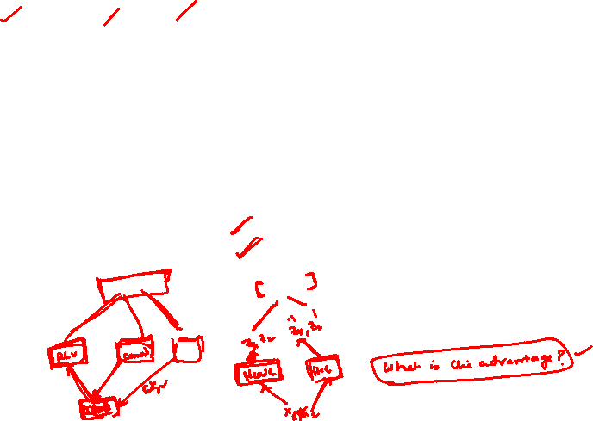
Head 2 — Self-Attention
Different learned weights → a different attention pattern
Query / Key / Value projections
Head 1 gave x₂ an asymmetric split — [0.670, 0.330] — favoring its own token.
Head 2, with different W_Q/W_K/W_V, gives x₂ an even [0.500, 0.500] split instead.
Same input tokens, same position — two heads extracted two different relationships.
That's the entire point of running several attention heads in parallel: each is free to specialize in a different kind of dependency.
2
Token | Q | K | V
x₁ | [1, 2] | [2, 0] | [1, 1]
x₂ | [1, 1] | [1, 1] | [2, 1]
Attention weights & output
Token | Softmax weights (t₁, t₂) | Head-2 Output
x₁ | [0.330, 0.670] | [1.67, 1.00]
x₂ | [0.500, 0.500] | [1.50, 1.00]
x₂'s raw scores tie exactly (2 = 2) → softmax splits attention 50/50 between the two tokens.

Slide 51

Concatenate Heads + Output Projection
Merge the two heads back into one d_model-sized vector
Concatenation
Token | Head 1 | Head 2 | Concatenated [h₁, h₂]
x₁ | [1.33, 1.00] | [1.67, 1.00] | [1.33, 1.00, 1.67, 1.00]
x₂ | [1.67, 1.00] | [1.50, 1.00] | [1.67, 1.00, 1.50, 1.00]
3
Output projection × Wₒ (4×3 → back to d_model = 3)
Token | Concatenated × Wₒ | Multi-Head Attention Output
x₁ | [1.33, 1.00, 1.67, 1.00] × Wₒ | [3.00, 2.67, 2.33]
x₂ | [1.67, 1.00, 1.50, 1.00] × Wₒ | [3.17, 2.50, 2.67]
Wₒ learns how to best recombine information gathered by every head into a single vector — this is the last step inside the multi-head attention sublayer, before the residual connection.

Slide 52
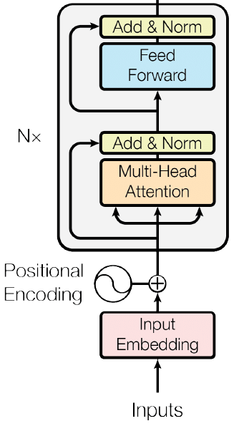

Residual Connection + Layer Norm
Add the block's input back in, then normalize
Add & Norm (shown for token x₁)
Residual add
x₁ + MHA₁ = [1,0,1] + [3.00, 2.67, 2.33]
= [4.00, 2.67, 3.33]
Mean
(4.00 + 2.67 + 3.33) / 3 = 3.333
Variance
mean of squared deviations = 0.294
Std dev
√0.294 = 0.543
Normalize
(each value − mean) / std
≈ [1.228, −1.221, −0.006]
(γ = 1, β = 0 for simplicity — in practice these are learned scale/shift parameters. Token x₂ follows the identical procedure.)

Slide 53

Position-Wise Feed-Forward Network
Same two linear layers, applied identically to every token
Expand → ReLU → project back (shown for token x₁)
1
Input
LN(Residual₁)
[1.228, −1.221, −0.006]
2
Layer 1 (× W₁, d_ff = 4)
pre-activation
[1.222, −2.449, −1.215, 2.443]
3
ReLU
negatives zeroed
[1.222, 0, 0, 2.443]
4
Layer 2 (× W₂, back to d_model = 3)
FFN output
[3.665, 0, 1.222]
The FFN's weights (W₁, W₂) are shared across every position in the sequence — this is what “position-wise” means. Only the attention sublayer lets tokens exchange information; the FFN processes each one independently.

Slide 54

Summary
Token x₁ traced start to finish — then the output feeds into the next stacked layer
Embeddings + positional encoding
x₁ = [1, 0, 1]
Multi-head self-attention
2 heads → concat → ×Wₒ = [3.00, 2.67, 2.33]
Residual + LayerNorm
≈ [1.228, −1.221, −0.006]
Position-wise feed-forward
[3.665, 0, 1.222]
Residual + LayerNorm
[4.893, −1.221, 1.216] → normalize
Pass to next encoder layer
repeats 6–12× in real models
The decoder adds one more sublayer — cross-attention to the encoder's output — and masks future positions in self-attention.

Slide 55
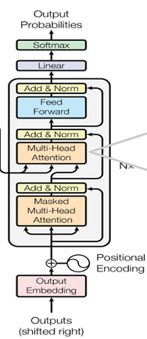
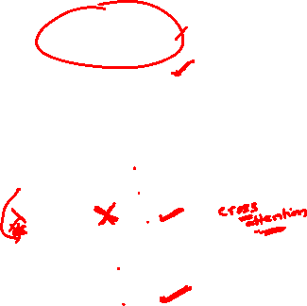
Transformer _ Decoder Only
(Numerical)
Thanks to LLMs for providing the relevant content

Slide 56

Setup
Same weight matrices as the encoder example — the mask is the only structural change
Dimensions : model = 4 ,Key = Value = 3
Task: Next word prediction; The cat sat -------
single head, 3 tokens: x1="The", x2="cat", x3="sat"
 | d1 | d2 | d3 | d4
x1 | 1 | 0 | 1 | 0
x2 | 0 | 1 | 0 | 1
x3 | 1 | 1 | 0 | 0
Input embeddings (X)
Weight matrices (learned parameters, 4×3 each)
Wq
Wk
Wv
1 | 0 | 1
1 | 0 | 0
0 | 0 | 1
0 | 1 | 1
0 | 0 | 1
1 | 1 | 0
0 | 1 | 0
1 | 1 | 0
0 | 2 | 0
0 | 3 | 0
1 | 0 | 3
1 | 1 | 0
Causal mask — token i sees only tokens 1..i
No encoder, no cross-attention
Used for generation (GPT): text completion, chat, one token at a time
Decoder-only means:

Slide 57
Step 1 — Project into Q, K, V
Q = X·Wq K = X·Wk V = X·Wv
Q
K
V
 | q1 | q2 | q3
x1 | 1 | 0 | 2
x2 | 1 | 1 | 1
x3 | 2 | 0 | 1
 | k1 | k2 | k3
x1 | 0 | 1 | 1
x2 | 2 | 2 | 0
x3 | 1 | 1 | 1
 | v1 | v2 | v3
x1 | 1 | 2 | 3
x2 | 1 | 4 | 0
x3 | 0 | 5 | 0
New this time — Q3, K3, V3 for "sat":
x3·Wq = [2,0,1] x3·Wk = [1,1,1] x3·Wv = [0,5,0]
Every token still gets its own Query, Key, and Value vector — identical mechanics to the encoder.
The difference comes next.

Slide 58

Step 2 — Score, then Apply the Causal Mask
This mask is the entire mechanical difference from an encoder block
Raw scores (Q·Kᵀ)
After causal mask (future = −∞)
 | K1 | K2 | K3
Q1 | 2 | 2 | 3
Q2 | 2 | 4 | 3
Q3 | 1 | 4 | 3
 | K1 | K2 | K3
Q1 | 2 | −∞ | −∞
Q2 | 2 | 4 | −∞
Q3 | 1 | 4 | 3
What the mask enforces
Row Q1 ("The") keeps only its score against K1 — it cannot see "cat" or "sat" yet.
Row Q2 ("cat") keeps scores against K1, K2 — it can see "The" and itself, not "sat".
Row Q3 ("sat") keeps all three — by the last position, everything before it is visible.

Slide 59

Steps 3–4 — Scale & Softmax
scaled = masked_scores / √d (√3 ≈ 1.732), then softmax row-wise
Scaled scores
Softmax weights (row-wise)
 | K1 | K2 | K3
Q1 | 1.155 | −∞ | −∞
Q2 | 1.155 | 2.309 | −∞
Q3 | 0.577 | 2.309 | 1.732
 | K1 | K2 | K3
Q1 | 1.000 | 0.000 | 0.000
Q2 | 0.240 | 0.760 | 0.000
Q3 | 0.102 | 0.575 | 0.323
Row 3 worked out — token "sat" attending to all prior tokens
e^0.577 = 1.781, e^2.309 = 10.07, e^1.732 = 5.652, sum = 17.50
[1.781, 10.07, 5.652] / 17.50 = [0.102, 0.575, 0.323]
Masked positions get exactly 0 weight — softmax turns −∞ into 0 probability, so no information leaks from the future.

Slide 60

Step 5 — Weighted Output Z = softmax · V
4
Z1 = 1.0·[1,2,3] = [1.000, 2.000, 3.000]
Z2 = 0.24·[1,2,3] + 0.76·[1,4,0] = [1.000, 3.520, 0.720]
Z3 = 0.102·[1,2,3] + 0.575·[1,4,0] + 0.323·[0,5,0] = [0.677, 4.119, 0.305]
 | z1 | z2 | z3
x1 | 1.000 | 2.000 | 3.000
x2 | 1.000 | 3.520 | 0.720
x3 | 0.677 | 4.119 | 0.305
Final causal self-attention output (Z)
Z1 and Z2 exactly match the encoder-only example — at those early positions the causal mask hides nothing new. Z3 is unique to the decoder: it blends all three tokens, leaning most on x2 "cat" (57.5%).
Reading the result

Slide 61
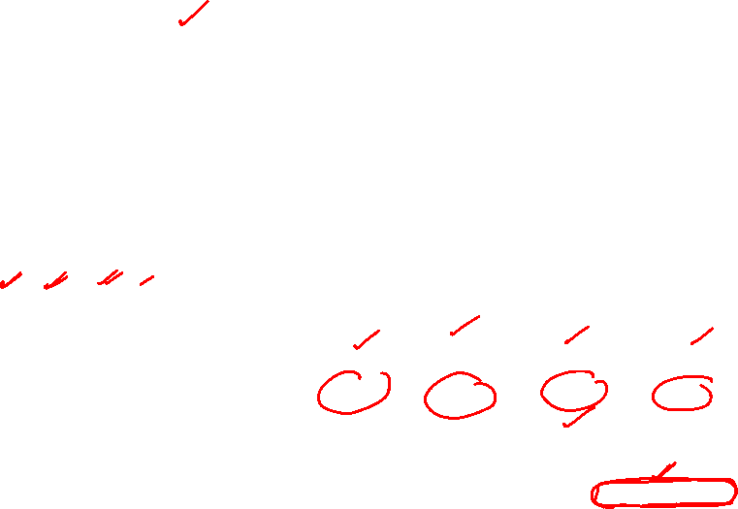
Step 6 — Predict the Next Token
Decoder-only's real job: only the last position's vector feeds the output layer
W_out (3×4, one column per vocab word)
logits = Z3 · W_out
1 | 0 | 2 | 1
0 | 1 | 1 | 0
1 | 1 | 0 | 2
[0.677, 4.119, 0.305] · W_out = [0.982, 4.424, 5.473, 1.287]
Softmax over vocab:
e^0.982=2.67, e^4.424=83.35, e^5.473=238.0, e^1.287=3.62, sum=327.6
vocab = {on, quickly, down, up}
word | on | quickly | down | up
probability | 0.008 | 0.254 | 0.726 | 0.011
Next-token probability distribution
"down" wins at 72.6% — e.g. completing "The cat sat down." That word is appended to the sequence, and the whole causal-attention process repeats to predict the token after it.
Autoregressive generation

Slide 62
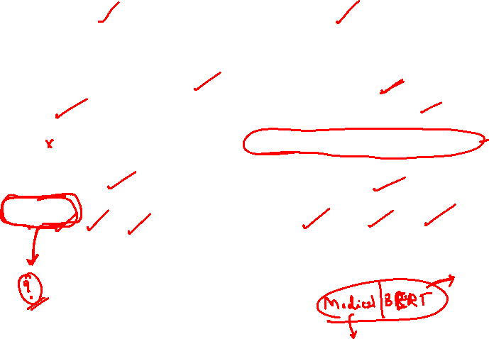
Encoder-Only vs. Decoder-Only
↔
 | Encoder-only (BERT-style) | Decoder-only (GPT-style)
Attention direction | Bidirectional — every token sees every token | Causal — token i sees only tokens ≤ i
Extra step | None | Mask applied before softmax
Cross-attention | None | None (only in encoder–decoder models)
Typical output | Contextual embeddings, all tokens in parallel | One next-token distribution per position
Typical use | Classification, NER, embeddings | Text generation, completion, chat

Slide 63
Transformer(complete)
(Numerical )
Thanks to LLMs for providing the relevant content

Slide 64

Setup
Input : English – I am a man
Output : Hindi – मैं एक आदमी हूं
English token | Embedding
I | x₁ = [1, 0, 1]
am | x₂ = [0, 1, 1]
a | x₃ = [1, 1, 0]
man | x₄ = [0, 0, 1]
मैं एक आदमी हूं
main ek aadmī hūँ
Decoder sequence (teacher forcing):
<start>, मैं, एक, आदमी, हूं → predicts → मैं, एक, आदमी, हूं, <end>
Dimension(model) = 3 · single head · W_Q = W_K = W_V = I (so Q = K = V = embedding)
NOTE : Residual-add, LayerNorm, and the position-wise FFN are not re-derived here — that exact arithmetic (mean/variance/normalize, expand→ReLU→project) was already worked through earlier step by step in the self-attention . This example focuses on what's new: cross-attention and autoregressive decoding.

Slide 65
Encoder Self-Attention — Raw Scores
Every source token compared against every other source token
Q · K (= xᵢ · xⱼ since Q = K = X)
1
 | I | am | a | man
I | 2 | 1 | 1 | 1
am | 1 | 2 | 1 | 1
a | 1 | 1 | 2 | 0
man | 1 | 1 | 0 | 1
Scale every score by ÷√d = ÷1.732 before softmax — same scaling rule as the single-sentence example.
Notice the diagonal is always highest (a token is most similar to itself) and “a”/“man” score 0 — with real trained embeddings, semantically related words would score higher, not just identical ones.
3

Slide 66

Encoder Self-Attention — Output
Softmax weights blend the embeddings into context-aware vectors
Softmax weights & resulting context vectors
2
Token | → I | → am | → a | → man | Context vector
I | 0.373 | 0.209 | 0.209 | 0.209 | [0.582, 0.418, 0.791]
am | 0.209 | 0.373 | 0.209 | 0.209 | [0.418, 0.582, 0.791]
a | 0.230 | 0.230 | 0.410 | 0.129 | [0.641, 0.641, 0.590]
man | 0.281 | 0.281 | 0.158 | 0.281 | [0.438, 0.438, 0.842]
These become Enc₁..Enc₄ (the encoder's final output)
After add & norm and the position-wise FFN (same mechanics as before, not re-derived here), these context vectors become Enc₁..Enc₄. They are cached once and reused by every decoder layer, at every decoding step — the encoder runs exactly once per sentence.

Slide 67

Decoder Step 1 — Masked Self-Attention
Generating the very first Hindi word
Only <start> is available
3
WHAT “MASKED” MEANS
y₀ = <start> = [1, 1, 1]
Once मैं is generated and fed back in at Step 2, it can attend to <start> and itself — never to words generated after it.
The mask sets those future-position scores to −∞ before softmax, so their weight becomes exactly 0. This lets the whole target sequence be trained in parallel while still matching true one-word-at-a-time generation.
With only one token in the decoder sequence, the causal mask has nothing to hide — <start> can only attend to itself.
Attention weight = 1.0
SelfAttn₀ = y₀ = [1, 1, 1] (unchanged)

Slide 68
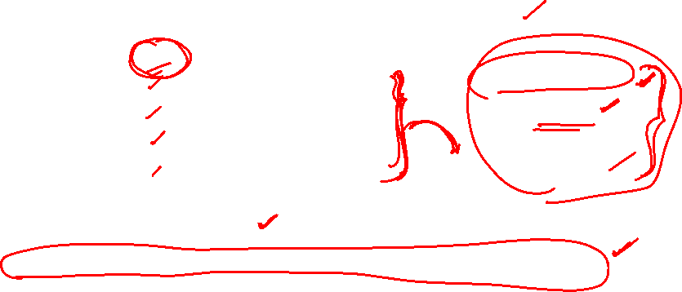
Cross-Attention
Decoder Query meets Encoder Key/Value — this is how source meaning reaches the target
Q from decoder, K & V from the encoder's output
4
Encoder token | Raw score (Q·Enc) | Scaled | Softmax weight
I | 1.791 | 1.034 | 0.250
am | 1.791 | 1.034 | 0.250
a | 1.872 | 1.081 | 0.262
man | 1.718 | 0.992 | 0.239
Q_dec = SelfAttn₀
= [1, 1, 1]
scaled by ÷√3
= ÷1.732
CROSS-ATTENTION OUTPUT
0.250·Enc₁ + 0.250·Enc₂ + 0.262·Enc₃ + 0.239·Enc₄ = [0.522, 0.522, 0.750]
Weights are fairly even here because the query [1,1,1] doesn't discriminate strongly — with real trained weights, the query for “I” would sharply prefer the encoder position for “I.”

Slide 69

Final Linear Layer + Softmax
Project to vocabulary size, then pick the most likely Hindi word
d₁ = [1,1,1] + [0.522, 0.522, 0.750] = [1.522, 1.522, 1.750] (post add & norm + FFN)
Candidate word | Weight vector | Logit | Probability
मैं (main) | [1, 1, 1] | 4.794 | 0.884
हूं (hūँ) | [0, 0, 1] | 1.750 | 0.042
एक (ek) | [1, 0, 0] | 1.522 | 0.033
आदमी (aadmī) | [0, 1, 0] | 1.522 | 0.033
<end> | [0, 0, 0] | 0.000 | 0.007
Predicted word: मैं (main) — argmax, 88.4% confidence ✓

Slide 70
Autoregressive Continuation
The predicted word feeds back in; Steps 3–6 repeat until <end>
One word at a time
6
Step | Decoder input so far | Masked self-attn sees | Predicted word
1 | <start> | <start> only | मैं
2 | <start>, मैं | <start>, मैं | एक
3 | <start>, मैं, एक | <start>, मैं, एक | आदमी
4 | <start>, मैं, एक, आदमी | all four | हूं
5 | <start>, मैं, एक, आदमी, हूं | all five | <end> — stop
Final translation:
मैं एक आदमी हूं
(main ek aadmī hūँ)

Slide 71
Encoder runs once; the decoder loop repeats once per output word
1
Encoder: self-attention over source
“I am a man” → Enc₁..Enc₄
2
Encoder: add & norm, then FFN
cached once per sentence
3
Decoder: masked self-attention
sees only prior target words
4
Decoder: cross-attention to Enc₁..Enc₄
pulls in source meaning
5
Decoder: add & norm, FFN, add & norm
same mechanics as the encoder
6
Final linear + softmax → next word
repeat until <end>
“I am a man” → मैं एक आदमी हूं

Slide 72
Transformer(complete)
(Numerical )
Task: Translate –”My name is Ravi” into
French “Mon, nom, est, Ravi”

Slide 73
The Full Pipeline, End to End
Nine steps: four build the encoder, five build the decoder.
ENCODER (reads English)
DECODER (writes French)
1
Input Embedding
5
Decoder Embedding
Token → dense vector
French tokens (shifted right) + PE
2
Positional Encoding
6
Masked Self-Attention
Inject word order (sin/cos)
Attend only to earlier French words
3
Self-Attention
7
Cross-Attention
Each English word gathers context
French queries read the English encoder output
4
Add & Norm + FFN
8
Feed-Forward
Per-position transform → encoder output
Add & Norm → final decoder representation
9
Linear + Softmax
Probability over French vocabulary
Step 4's output (the encoded English sentence) is read by Step 7 — that's where translation alignment happens.

Slide 74

STEP 1 · ENCODER _Input Embeddings
Each token is looked up in an embedding table — here, a toy 4-dimensional vector.
1
My
0.10 | 0.20 | 0.30 | 0.40
name
0.50 | 0.10 | 0.20 | 0.30
is
0.20 | 0.40 | 0.10 | 0.30
Ravi
0.90 | 0.80 | 0.70 | 0.60
X = the 4×4 matrix stacking all four rows — this is the encoder's raw input before any position information is added.

Slide 75
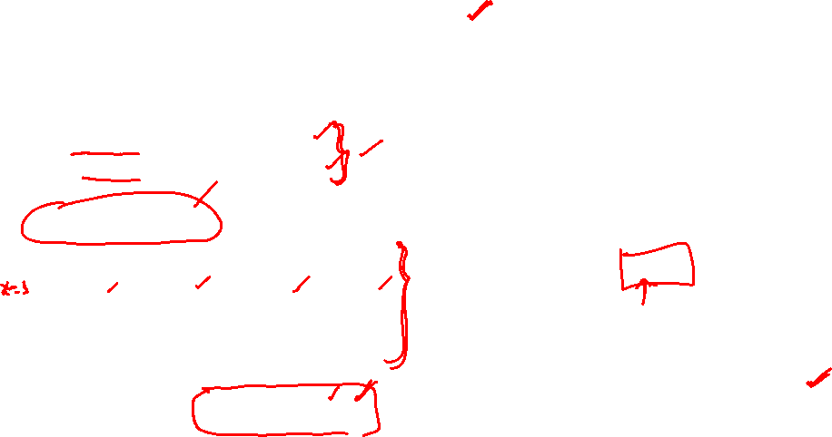
STEP 2 · ENCODER _ Positional Encoding
Sine/cosine signals inject word-order information, since attention itself is order-blind.
2
PE(pos, 2i) = sin( pos / 10000^{2i/d} )
PE(pos, 2i+1) = cos( pos / 10000^{2i/d} )
Positional Encoding (PE) — rows = position 0..3
0.0000 | 1.0000 | 0.0000 | 1.0000
0.8415 | 0.5403 | 0.0100 | 1.0000
0.9093 | -0.4161 | 0.0200 | 0.9998
0.1411 | -0.9900 | 0.0300 | 0.9996
0.10 | 1.20 | 0.30 | 1.40
1.34 | 0.64 | 0.21 | 1.30
1.11 | -0.02 | 0.12 | 1.30
1.04 | -0.19 | 0.73 | 1.60
Encoder input = X + PE
Row order = My, name, is, Ravi. This X_in matrix is what actually enters the self-attention layer next.

Slide 76
Why Position Information Is Needed
Self-attention on its own has no idea what order the words came in.
Self-attention treats a sentence as a SET, not a sequence
Q, K, V are computed independently per token and combined only through weighted averages — nothing in that math depends on where a token sits.
Original order
Scrambled order
My
name
is
Ravi
Ravi
is
name
My
Same multiset of embeddings in → the exact same attention weights and outputs come out, regardless of which order the four words were fed in.
That's clearly wrong for language — "Ravi is name My" is not the same sentence. Positional encoding fixes this by adding a position-specific fingerprint to each embedding before attention ever runs, so word order becomes part of the numbers themselves.

Slide 77
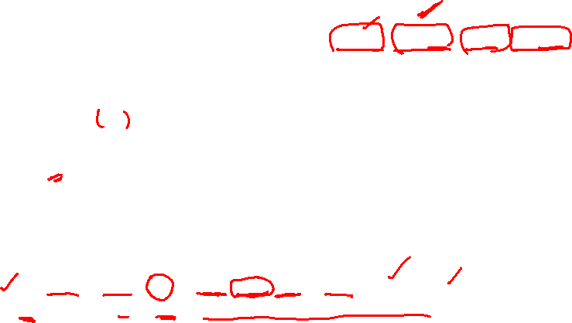
Positional Encoding
Every symbol in PE(pos, i) maps to something concrete.
pos
Token's position in the sequence — 0 for "My", 1 for "name", 2 for "is", 3 for "Ravi".
i
Indexes pairs of dimensions. With d_model = 4: i=0 → dims 0–1, i=1 → dims 2–3.
sin / cos
Even dimension → sine, odd dimension → cosine. Each (i) pair forms one wave oscillating at its own frequency.
10000^(2i/d)
Controls wavelength. Low i = fast-changing wave; high i = slow-changing wave — like a clock's second hand and hour hand together pinning down a specific time.
Worked example — pos = 1 ("name")
i=0: angle = 1 / 10000⁰ = 1.0 → PE(1,0)=sin(1.0)=0.8415, PE(1,1)=cos(1.0)=0.5403
i=1: angle = 1 / 10000^{0.5} = 0.01 → PE(1,2)=sin(0.01)=0.0100, PE(1,3)=cos(0.01)=1.0000

Slide 78
Why Sine and Cosine, Specifically
Not just any position signal works — this one has three properties that matter.
2c
Bounded values
Relative position ≈ linear
Deterministic, not learned
Raw position counts (0,1,2,3…) grow without limit and would swamp the embedding. sin/cos always stay in [-1, 1].
PE(pos+k) is a linear function (a rotation) of PE(pos), via trig addition formulas — helping the model learn by relative offset, not just absolute position.
Computed once from a formula — no extra parameters, and it generalizes to sequence lengths never seen in training.
PE values across positions 0–20 (all 4 dimensions of this toy model)

Slide 79

ENCODER(Self-Attention)
Every English word compares itself against every other English word.
Q = X_in · WQ K = X_in · WK V = X_in · WV
W_Q, W_K, W_V are learned 4×4 matrices (shown here at their random-initialization values).
scores = Q · Kᵀ / √d weights = softmax(scores)
output = weights · V
Softmax attention weights (rows sum to 1)
 | My | name | is | Ravi
My | 0.208 | 0.262 | 0.248 | 0.282
name | 0.211 | 0.271 | 0.222 | 0.296
is | 0.239 | 0.269 | 0.214 | 0.277
Ravi | 0.252 | 0.271 | 0.208 | 0.270
Attention output (weights · V) → each word's representation now blends in context from the others.
0.112 | 0.165 | 0.505 | -0.272
0.116 | 0.170 | 0.500 | -0.268
0.108 | 0.179 | 0.478 | -0.255
0.105 | 0.184 | 0.467 | -0.249
Add & Norm (residual + LayerNorm) closes out this sub-layer before the feed-forward network.

Slide 80
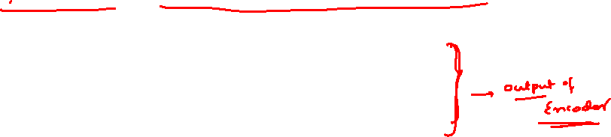
ENCODER _ Feed-Forward → Final Encoder Output
A position-wise FFN, then Add & Norm, produces the representation the decoder will read.
FFN(x) = ReLU(x·W₁)·W₂ (dims 4 → 8 → 4, applied independently to each position)
FINAL ENCODER OUTPUT
-1.451 | 1.205 | -0.331 | 0.577
1.644 | -0.593 | -0.970 | -0.081
1.131 | -1.466 | -0.340 | 0.675
0.389 | -1.716 | 0.553 | 0.773
My name is Ravi
This matrix is the encoder's final output.
It's a contextualized representation of "My name is Ravi" — each row still corresponds to one English word, but now carries information gathered from the whole sentence.
The decoder never sees the raw English words again. From this point on, it only sees this matrix — via cross-attention in Step 7.

Slide 81

DECODER - Masked Self-Attention
The decoder reads its own (shifted) output so far — but never the future.
5
Decoder input (teacher-forced, shifted right):
<sos>
Mon
nom
est
target to predict: Mon, nom, est, Ravi
Causal mask — future positions forced to −∞ before softmax
 | <sos> | Mon | nom | est
<sos> | 1.00 | — | — | —
Mon | 0.51 | 0.49 | — | —
nom | 0.33 | 0.32 | 0.34 | —
est | 0.25 | 0.23 | 0.25 | 0.27
Why mask?
At training and inference time, the decoder must predict each word using only the words already generated. "est" (row 4) attends across <sos>, Mon, nom, and itself — but 0% to "Ravi", which doesn't exist yet at that point.
This is what makes the decoder autoregressive.

Slide 82
DECODER: Cross-Attention — Where Translation Happens
French queries; English keys and values. This is the alignment step.
Q ← decoder (French)
K, V ← encoder output (English)
Cross-attention weights — each French position's focus over English
 | My | name | is | Ravi
<sos> | 0.257 | 0.171 | 0.236 | 0.336
Mon | 0.409 | 0.149 | 0.194 | 0.248
nom | 0.447 | 0.206 | 0.189 | 0.158
est | 0.317 | 0.344 | 0.222 | 0.118
Highlighted = strongest link
Mon" and "nom" both attend most to "My" — a sensible pattern even in this untrained toy model.
In a fully trained transformer, this table is what learns real alignments: Ravi ↔ Ravi, name ↔ nom, is ↔ est.

Slide 83

DECODER: Feed-Forward → Linear → Softmax
The final projection turns the decoder state into word probabilities.
8
Decoder saw | Mon | nom | est | Ravi | <eos> | Predicted
<sos> | 0.195 | 0.190 | 0.155 | 0.187 | 0.273 | <eos>
Mon | 0.301 | 0.140 | 0.305 | 0.106 | 0.148 | est
nom | 0.365 | 0.122 | 0.319 | 0.108 | 0.086 | Mon
est | 0.311 | 0.167 | 0.157 | 0.221 | 0.144 | Mon
Why the predictions look "wrong"
Every weight matrix used in this walkthrough (W_Q, W_K, W_V, W₁, W₂, W_out) was randomly initialized, not trained. The goal was to make the mechanics traceable by hand — embedding → positional encoding → self-attention → cross-attention → feed-forward → softmax — not to reproduce a correct translation.
During real training, backpropagation adjusts every matrix over millions of sentence pairs until cross-attention reliably aligns "Ravi"↔"Ravi", "name"↔"nom", "is"↔"est", "My"↔"Mon"/"m'appelle" — and softmax sharply peaks on the correct next word at each step.

Slide 84
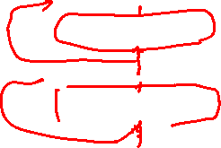
TRANSFORMERS

Slide 85



Slide 86
BERT
BERT, which stands for Bidirectional Encoder Representations from Transformers.
In 2018, Google introduced and open-sourced BERT. In its research stages, the framework achieved groundbreaking results in 11 natural language understanding tasks, including sentiment analysis, semantic role labeling, sentence classification ,words with multiple meanings etc.
BERT is a “deeply bidirectional” model. Bidirectional means that BERT learns information from both the left and the right side of a token’s context during the training phase

Slide 87
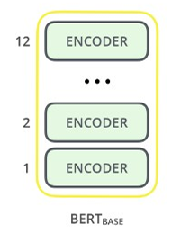
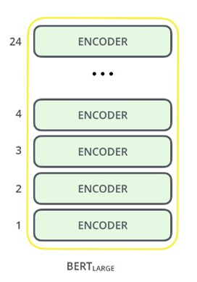
BERT
The BERT architecture builds on top of Transformer. We currently have two variants available:–
BERT Base: 12 layers (transformer blocks), 12 attention heads, and 110 million parameters–
BERT Large: 24 layers (transformer blocks), 16 attention heads and, 340 million parameter

Slide 88
Pre-trained models
patentBERT - a BERT model fine-tuned to perform patent classification.
docBERT - a BERT model fine-tuned for document classification.
bioBERT - a pre-trained biomedical language representation model for biomedical text mining.
VideoBERT - a joint visual-linguistic model for process unsupervised learning of an abundance of unlabeled data on Youtube.
SciBERT - a pretrained BERT model for scientific text
G-BERT - a BERT model pretrained using medical codes with hierarchical representations using graph neural networks (GNN) and then fine-tuned for making medical recommendations.

Slide 89
Pre-trained models
TinyBERT by Huawei - a smaller, "student" BERT that learns from the original "teacher" BERT, performing transformer distillation to improve efficiency. TinyBERT produced promising results in comparison to BERT-base while being 7.5 times smaller and 9.4 times faster at inference.
DistilBERT by HuggingFace - a supposedly smaller, faster, cheaper version of BERT that is trained from BERT, and then certain architectural aspects are removed for the sake of efficiency
AstraZeneca and NVIDIA developed MegaMolBART, a transformer tailored for drug discovery

Slide 90
Pre-training for three types of architectures
Encoder-only models
Gets bidirectional context – can condition on future!
How do we train them to build strong representations?
Also known as auto-encoding models
For tasks that require understanding of the input, e.g sentence classification and named entity recognition
Representatives of this family of models include:
  ALBERT, BERT, DistilBERT, , ELECTRA, RoBERTa

Slide 91
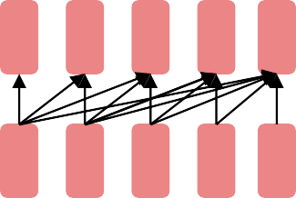
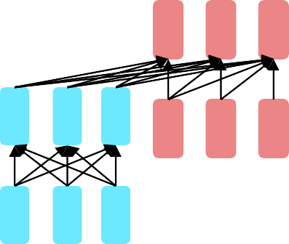
Pre-training for three types of architectures
Decoder-only models
Language models
Nice to generate from; can’t condition on future words
These models are also known as auto-regressive models.
Representatives of this family of models include:
  CTRL, GPT series, Transformer XL
Encoder-decoder models or sequence-to-sequence models
For generative tasks that require an input, such as translation or summarization . BART/T5-like

Slide 97


